Slide 1
Object Detection I:
RCNN, Fast-RCNN, Faster-RCNN

Slide 2
Today’s Class
Object Detection
The RCNN Object Detector (2014)
The Fast RCNN Object Detector (2015)
The Faster RCNN Object Detector (2016)

Slide 3
Object Detection
deer
cat
Notes:
Input: image
Output: object category and location for every object in the image
<number>

Slide 4
Object Detection as Classification
deer?
CNN
cat?
background?

Slide 5
Object Detection as Classification
deer?
CNN
cat?
background?

Slide 6
Object Detection as Classification
deer?
CNN
cat?
background?

Slide 7
Object Detection as Classification with Sliding Window
deer?
CNN
cat?
background?
Notes:
Main idea:
<number>

Slide 8
Object Detection as Classification with Box Proposals

Slide 9
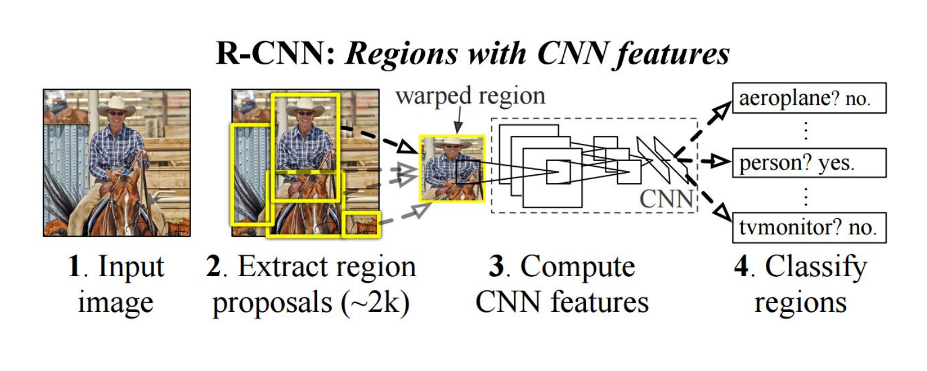
RCNN
https://people.eecs.berkeley.edu/~rbg/papers/r-cnn-cvpr.pdf
Rich feature hierarchies for accurate object detection and semantic segmentation. Girshick et al. CVPR 2014.

Slide 10
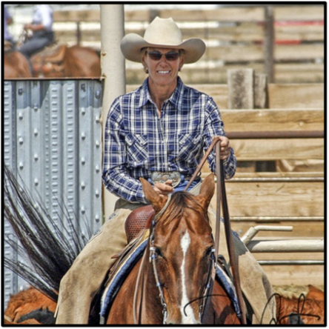
RCNN
First stage: generate category-independent region proposals.
2000 Region proposals for every image
Selective Search: combine the strength of both an exhaustive search and segmentation.
Uijlings et al. IJCV 2013.
ref
Notes:
On the one hand, use the image structure to guide the sampling process. On the other hand: aim to capture all possible object locations.

Slide 11
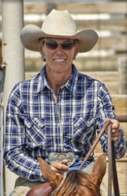
RCNN
First stage: generate category-independent region proposals.
2000 Region proposals for every image
Second stage: extracts a fixed-length feature vector from each region.
warp
feature vector
a 4096-dimensional feature vector from each region proposal
CNN
Arbitrary rectangles?
A fixed size input? 227 x 227
5 conv layers + 2 fully connected layers
Notes:
On the one hand, use the image structure to guide the sampling process. On the other hand: aim to capture all possible object locations.

Slide 12
RCNN
First stage: generate category-independent region proposals.
2000 Region proposals for every image
Second stage: extracts a fixed-length feature vector from each region.
feature vector
people?
a 4096-dimensional feature vector from each region proposal
linear
svm
horse?
background?
Third stage: a set of class- specific linear SVMs.
x
y
w
h
Bounding box regression
object category and location
proposal location
Notes:
On the one hand, use the image structure to guide the sampling process. On the other hand: aim to capture all possible object locations.

Slide 13
RCNN
Fast-RCNN
Simple and scalable.
improves mAP.
A multistage pipeline.
Training is expensive in space and time (features are extracted from each region proposal in each image and written into disk).
Object detection is slow.
?

Slide 14
Fast-RCNN
Idea: No need to recompute features for every box independently
https://arxiv.org/abs/1504.08083
Fast R-CNN. Girshick. ICCV 2015.

Slide 15
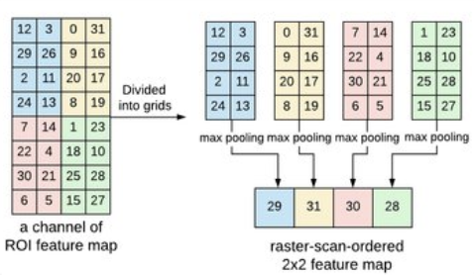
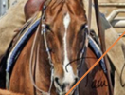
Fast-RCNN
Process the whole image with several convolutional (conv) and max pooling layers to produce a conv feature map.
a region of interest (RoI) pooling layer extracts a fixed-length feature vector from the region feature map.
FC+
softmax
feature vector
K + 1 categories
+
four real-valued numbers for each of the K object classes.
FC+
regressor
…

Slide 16
RCNN
Fast-RCNN
Faster-RCNN
Simple and scalable.
improves mAP.
Higher mAP.
Single stage, end-to-end training.
No disk storage is required for feature caching.
A multistage pipeline.
Training is expensive in space and time (features are extracted from each region proposal in each image and written into disk).
Object detection is slow.
?
proposals are the computational bottleneck in detection systems.

Slide 17
Faster-RCNN
Idea: Integrate the Bounding Box Proposals as part of the CNN predictions
https://arxiv.org/abs/1506.01497
Ren et al. NIPS 2015.

Slide 18
Faster-RCNN
Region Proposal Networks:
k anchors boxes
2k scores
4k coordinates
object or not object
bounding box proposal
RPN
1x1 conv layer
1x1 conv layer
cls layer
reg layer
nxn conv layer
Shared conv layers
Fast-RCNN
feature map
…
sliding window, nxn

Slide 19
RCNN
Fast-RCNN
Faster-RCNN
Simple and scalable.
improves mAP.
Higher mAP.
Single stage, end-to-end training.
No disk storage is required for feature caching.
compute proposals with a deep convolutional neural network --Region Proposal Network (RPN)
merge RPN and Fast R-CNN into a single network, enabling nearly cost-free region proposals.
A multistage pipeline.
Training is expensive in space and time (features are extracted from each region proposal in each image and written into disk).
Object detection is slow.
proposals are the computational bottleneck in detection systems.
?

Slide 20
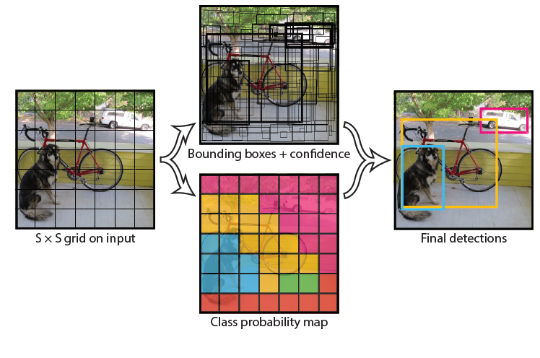
YOLO- You Only Look Once
Idea: No bounding box proposal. A single regression problem, straight from image pixels to bounding box coordinates and class probabilities.
extremely fast
reason globally
learn generalizable representations
https://arxiv.org/abs/1506.02640
Redmon et al. CVPR 2016.
Notes:
<number>

Slide 21
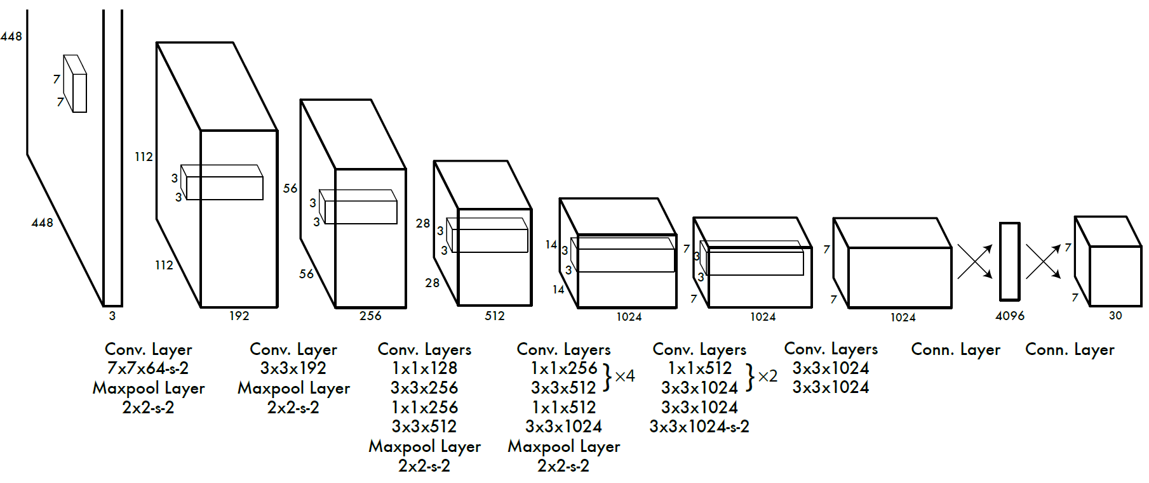
YOLO- You Only Look Once
Divide the image into 7x7 cells.
Each cell trains a detector.
The detector needs to predict the object’s class distributions.
The detector has 2 bounding-box predictors to predict
bounding-boxes and confidence scores.

Slide 22
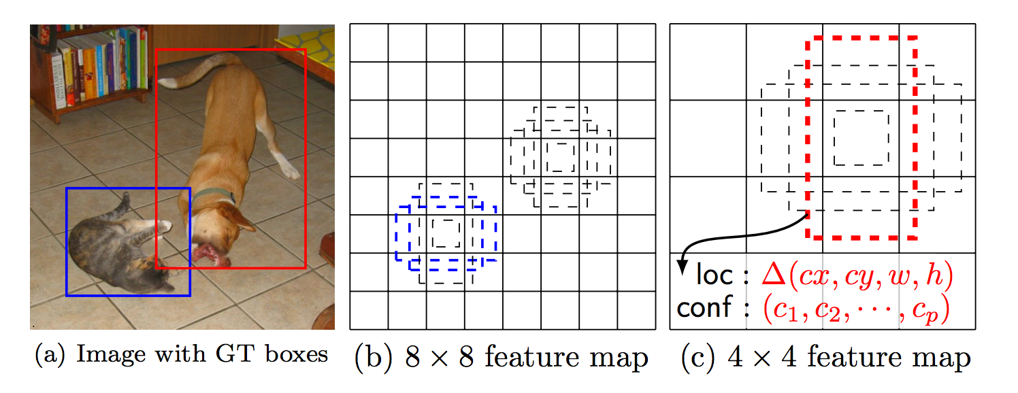
SSD: Single Shot Detector
Idea: Similar to YOLO, but denser grid map, multiscale grid maps. + Data augmentation + Hard negative mining + Other design choices in the network.
Liu et al. ECCV 2016.

Slide 23
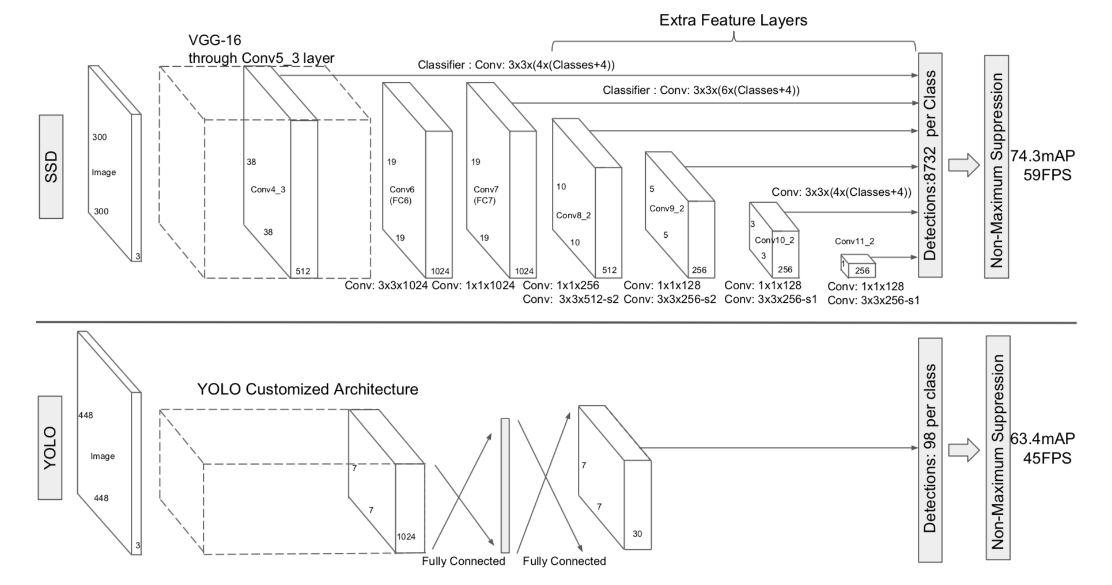

Slide 24
Questions?

